Slide 1
AIR QUALITY PREDITION BASED ON MACHINE LEARNING
UNDER THE GUIDENCE OF
D. Siva Gopi Reddy _{M.Tech}
SUBMITTED BY
NAME:-A. Siddesh
REG NO:(207T1A0501)

Slide 2
TEAM MEMBERS
A.SIDDESH 207T1A0501
P.VENKAT KUMAR 207T1A0525
B.PARIMILA 207T1A0502

Slide 3
CONTENTS
INTRODUCTION
EXISTING SYSTEM
PROPOSED SYSTEM
SOFTWARE REQURIMENTS
HARDWARE REQURIMENTS
UML DIAGRAMS
MODULES
CONCLUSION
REFERD LINKS

Slide 4
INTRODUCTION
Air Quality Prediction Based On Machine Learning (ML) Involves Using Historical Air Quality Data, Along With Other Relevant Environmental And Meteorological Variables, To Forecast Future Air Quality Levels.
It Has Been Increasingly Important Due To Their Significant Impacts On Human Health, Ecosystems, And Climate Change
The Combined Effects Of Ambient (Outdoor) And Household Air Pollution Cause About 7million Premature Deaths Every Year.

Slide 5
EXISTING SYSTEM
Predict Air Quality Using Machine Learning Techniques. The Dataset Is Divided Into Training And Testing Sets, And Feature Selection Is Applied To Identify Relevant Attributes
CAMS provides real-time forecasts and historical data on atmospheric composition, including pollutants such as PM2.5, PM10, NO2, and O3.
Improved Accuracy
Cost-effectiveness
Real-time Forecasting

Slide 6
PROPOSED SYSTEM
Aims to enhance air quality prediction by incorporating advanced machine learning algorithms like Random forest, decision tree ,svm
It includes ensemble learning, time-series analysis, and real-time monitoring for adapting to changing data.
The proposed system is developed to predict air quality using air database and then predict the air quality of the region.

Slide 7
HARDWARE REQUIREMENTS
System : Intel Core I5.
Hard Disk : 256 Gb.
Monitor : 15’’ Led
Input Devices : Keyboard, Mouse
Ram : 8GB.

Slide 8
SOFTWARE REQUIREMENTS
Operating system : Windows 10.
Coding Language : Python
Tool : Visual Studio Code
Database : SQLite

Slide 9
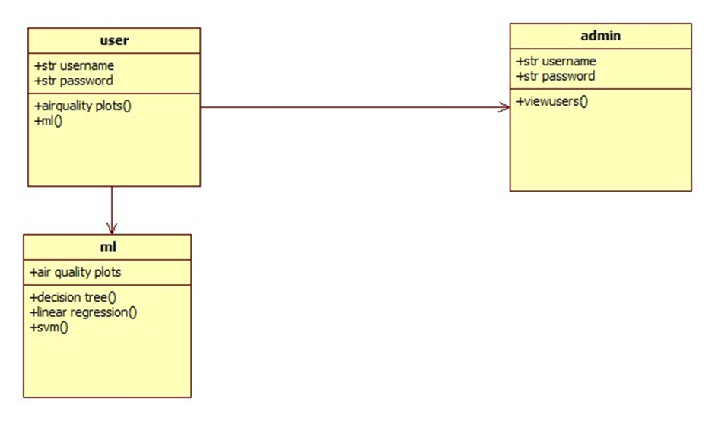
UML DIAGRAMS
CLASS DIAGRAMS

Slide 10
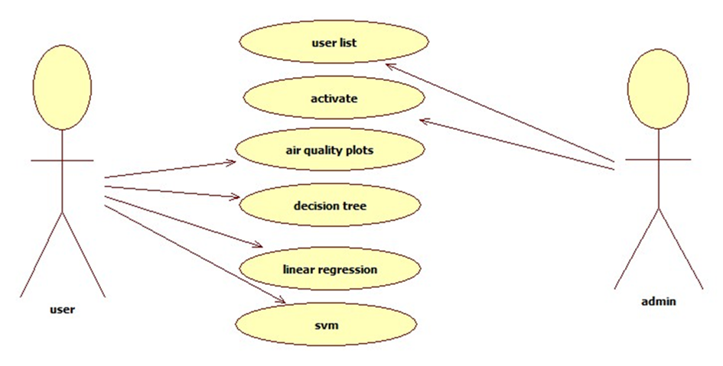
USE CASE

Slide 11
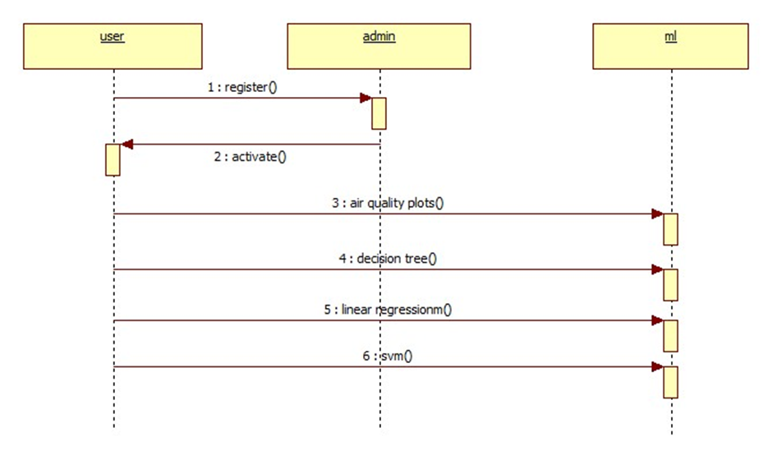
SEQUENCE DIAGRAM

Slide 12
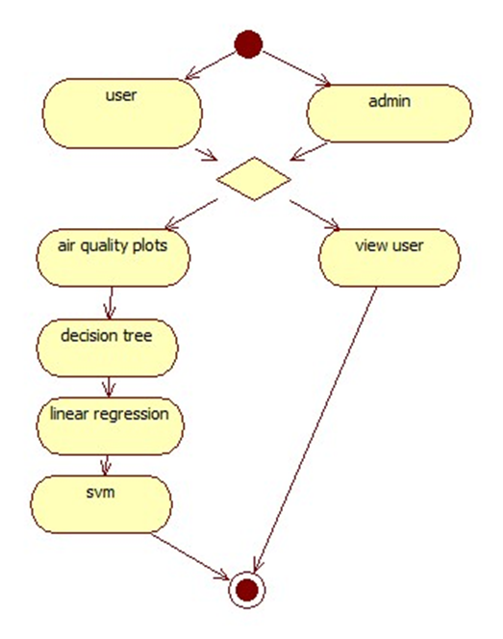
ACTIVITY DIAGRAM

Slide 13
MODULES
User:
The User can register the first. While registering he required a valid user email and mobile for further communications. Once the user registers, then admin can activate the customer
Admin:
Admin can login with his credentials. Once he logs in he can activate the users. The activated user only login in our applications.
Svm:
it is mostly used in classification problems.
Decision tree:
They represent decisions as a tree structure, guiding through feature-based choices to predict outcomes.

Slide 14
CONCLUSION
The current state-of-the-art in air quality prediction based on machine learning, high lighting the strengths, limitations, and future directions of research in this field.
Incorporating data from emerging sensor technologies, such as low-cost portable sensors, Internet-of-Things (IoT) devices, and satellite-based remote sensing, can enhance the spatial and temporal coverage of air quality monitoring.

Slide 15
Referred links
https://www.sciencedirect.com/science/article/pii/S004565352301785X

Slide 16
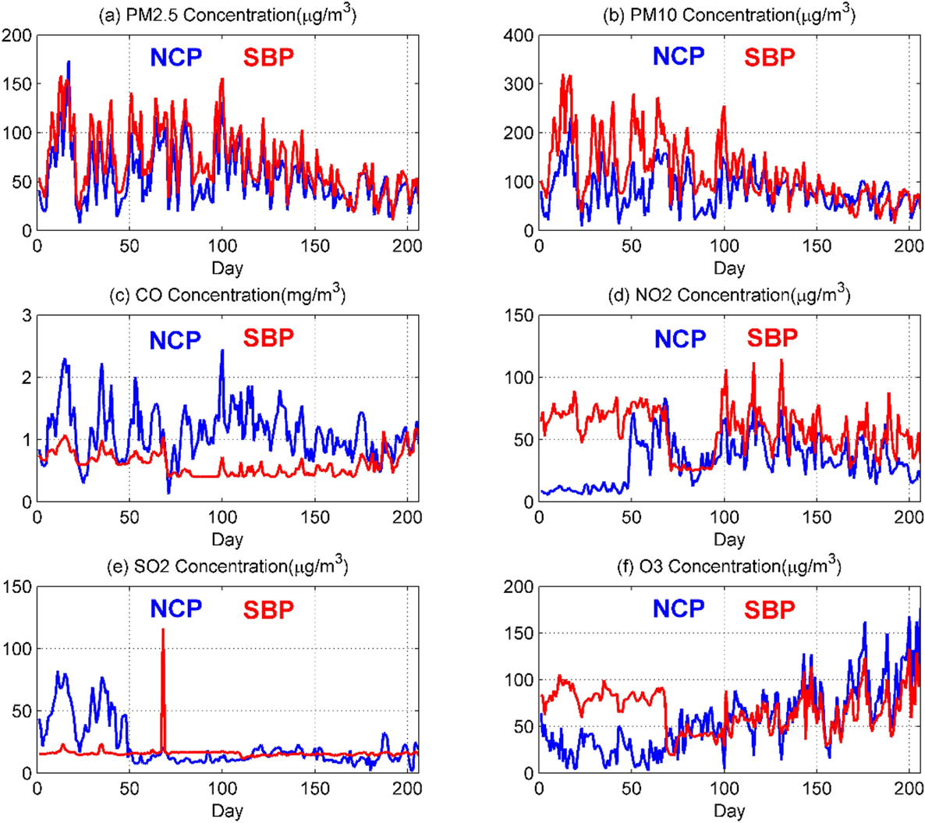

Slide 17
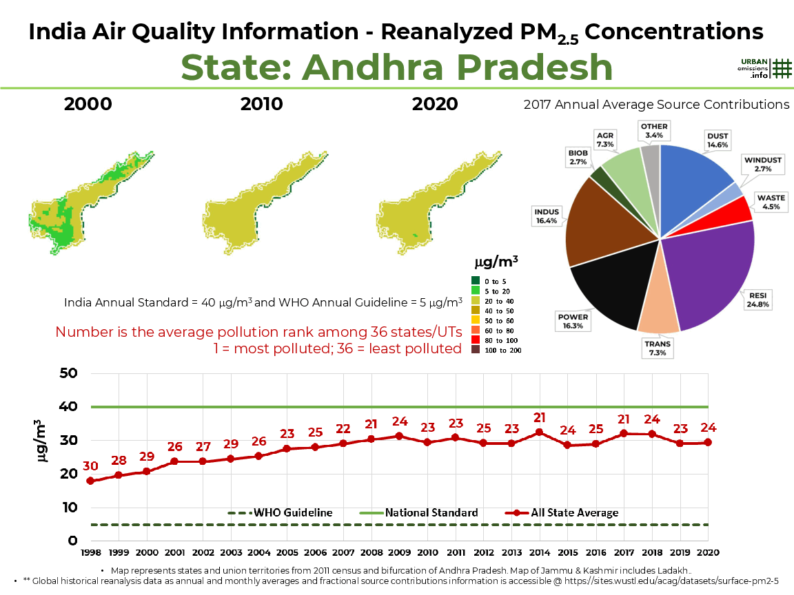

Slide 18
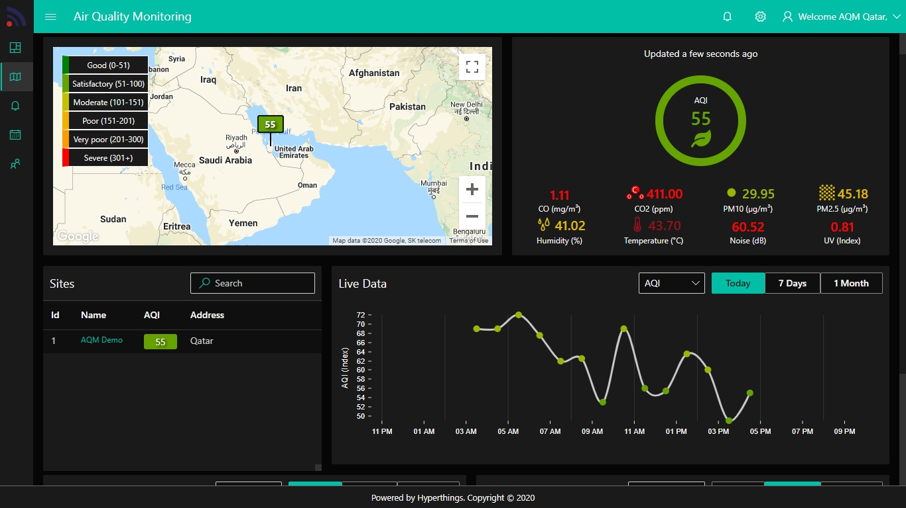

Slide 19


